Slide 1
Everything financial you want to know about becoming a data analyst
Notes:
kalan

Slide 2
Our Team
Kalan Suneson
Grant Ritzwoller
Repo Owner & Presentation
Coding & Visualization
Sebastian Andreu
Coding & Visualization
Gavin Lawson
Coding & Visualization
Notes:
kalan

Slide 3
Table of Contents
01
02
03
04
05
Salary VS Company Size
We will analyze what difference company size has against salary
Remote VS In Office
We will analyze the benefit of being in office
Experience VS Benefits
What does your experience impact your benefits
Good Info
Quick snapshot of some facts
Ten Years From Now
What will this job market look like
Notes:
kalan

Slide 4
01
Notes:
Switch to Gavin

Slide 5
Salary VS Company Size
Does the company size have an effect on salary? Which size company has better salaries?
Notes:
Gavin

Slide 6
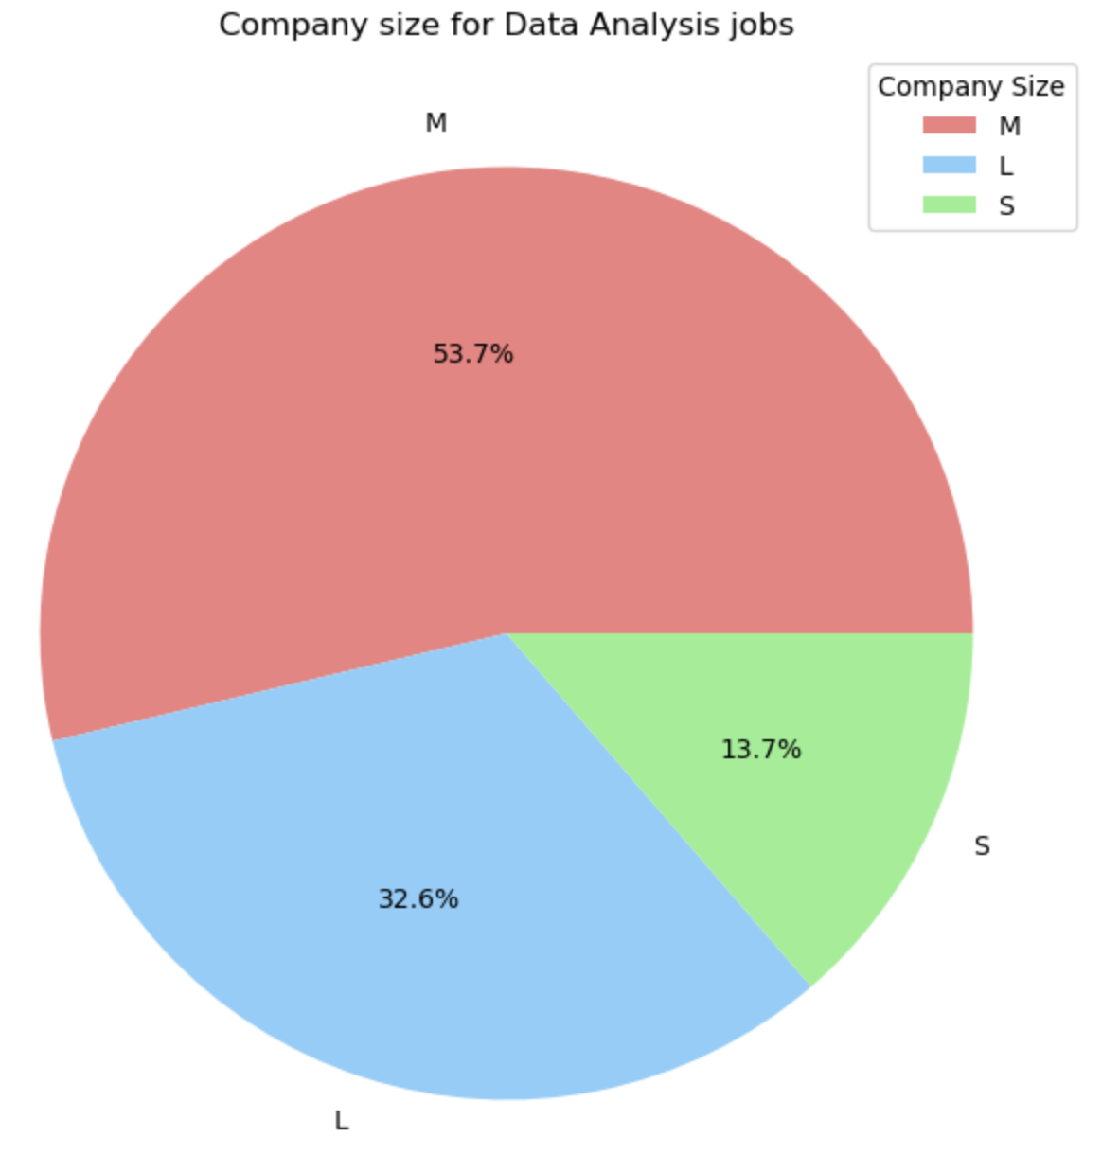
Salary VS Company Size
First we need to see the size of companies we are working with
Notes:
Gavin

Slide 7
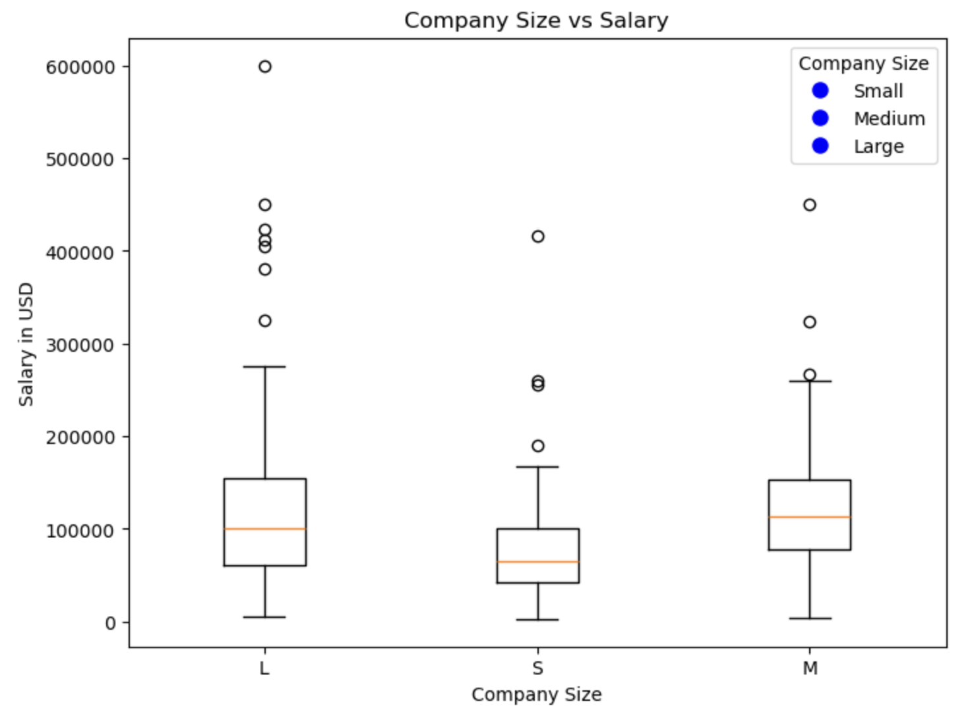
Salary VS Company Size
Then base those salaries off of the different company sizes
Notes:
Gavin

Slide 8
Salary VS Company Size Analysis
Does company size play a part and what can we determine about salaries and company sizes?
01
From the information that we gathered we can tell that most companies are medium sized companies. That medium and large companies have marginally the same average salary with there being a potential for making more within a large company due to the outliers that we found. There is also a potential for making more within a small company but it is the exception not the rule.
Notes:
Gavin

Slide 9

— Mark Twain
“Data is like garbage. You’d better know what you are going to do with it before you collect it.”
Notes:
Gavin

Slide 10
02
Notes:
Switch to Sebastian

Slide 11
Remote VS In Office
Is there a salary benefit from working in office vs remote?
Notes:
Sebastian

Slide 12
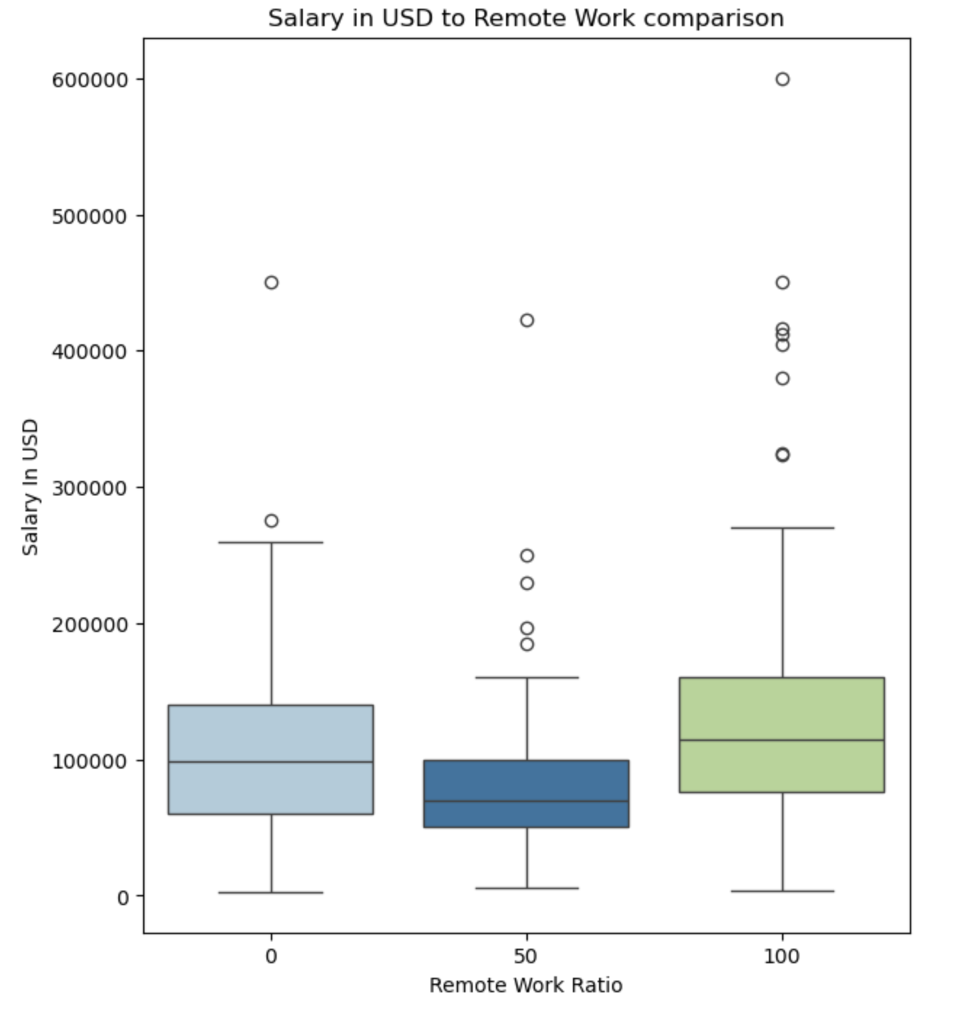
The following graph shows the % of remote work vs salary
The graph breaks up full time in office, hybrid 50/50 schedule, and then a full remote position with their relative salaries from 2020 - 2022.
Notes:
Sebastian

Slide 13
Remote VS In Office
Does working in office mean you will make more money?
02
From the information that we gathered we can tell that working in office does not necessarily mean you’ll make significantly more. Surprisingly most full time remote workers make more than in office. There also more outliers with fully remote positions, which gives you a bigger potential of making more with a fully remote job. It brings up the continued question though, do you ever really clock out if you work from home?
Notes:
Sebastian

Slide 14
— Jay Baer, marketing and customer experience expert
“We are surrounded by data, but starved for insights.”
Notes:
Sebastian

Slide 15
03
Notes:
Switch to Kalan

Slide 16
Experience VS Benefits
How much does experience impact salary and even other benefits like working remotely
Notes:
kalan

Slide 17
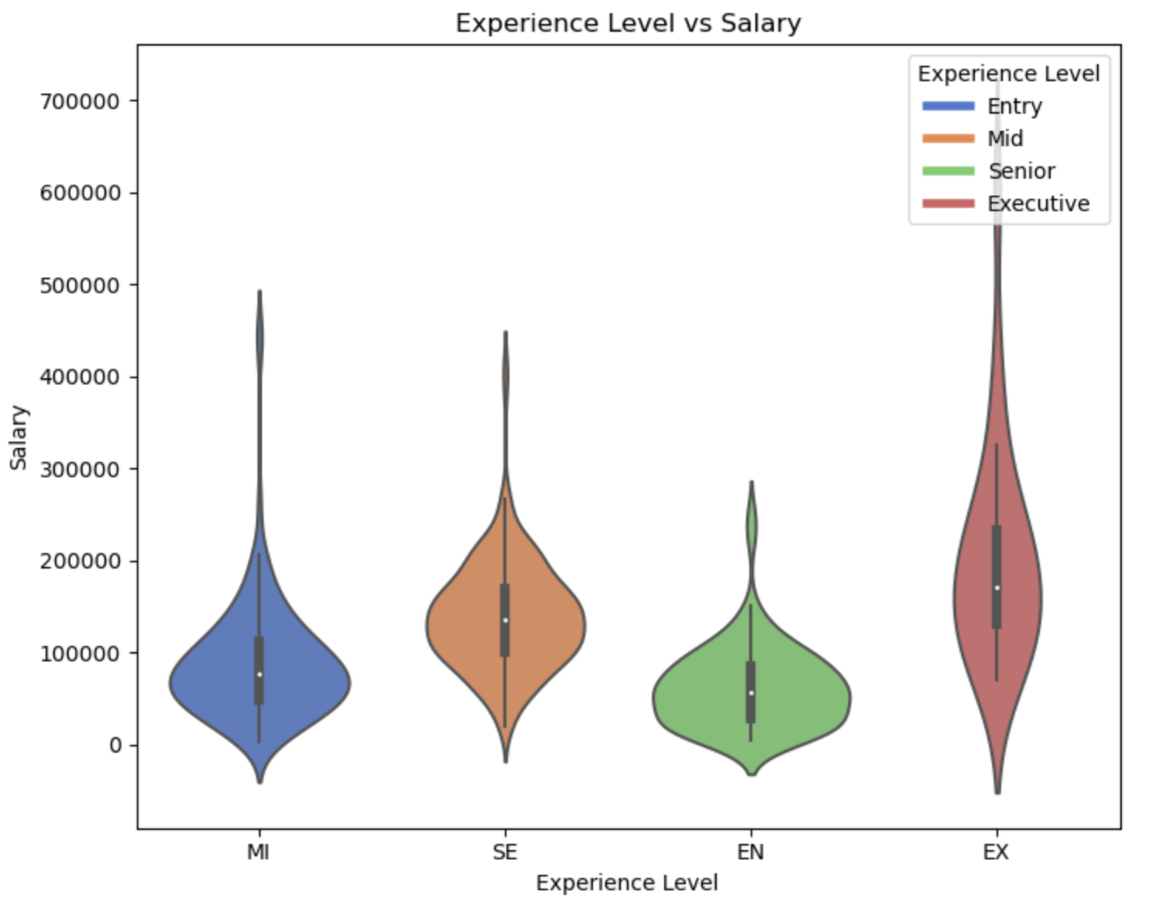
Experience VS Benefits
The following graph shows the salary versus experience levels
Notes:
kalan

Slide 18
Experience VS Benefits
Does experience guarantee a larger salary in this industry?
03
It is simple to assume that with more experience the bigger the salary. However with the data that we have formed it does show that there is not a drastic change from entry to senior. We can also conclude that most of the outliers that we have found are in executive roles. With the previous question we can also gather that remote employees usually make more and have more experience which opens a new question of is this considered a better benefit?
Notes:
kalan

Slide 19
04
Notes:
kalan

Slide 20
Good Info
Average salaries, job titles, ect
Notes:
kalan

Slide 21
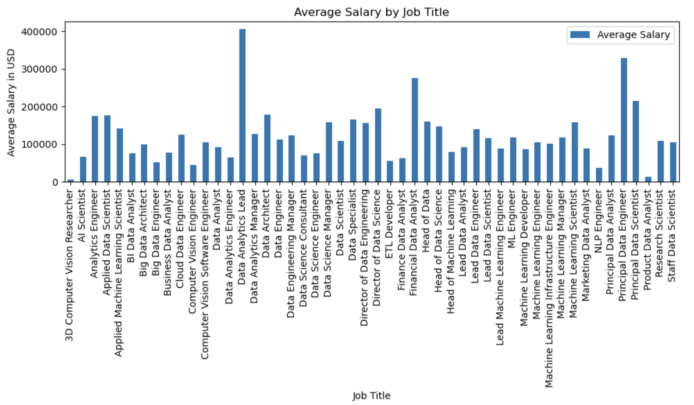
Does title matter??
There is a huge range of titles in this industry, based off the graph I would say it’s important with salary to make sure you apply for the right thing
Notes:
kalan

Slide 22
$115,000
Data Analytics Lead
Big Data Architect
Average Salary * 2022
Highest Paid Job Title
Team intrigued by this job title
Notes:
kalan

Slide 23
05
Notes:
Switch to Grant

Slide 24
Ten Years From Now
What does this industry look like in 10 years?
Notes:
Grant

Slide 25
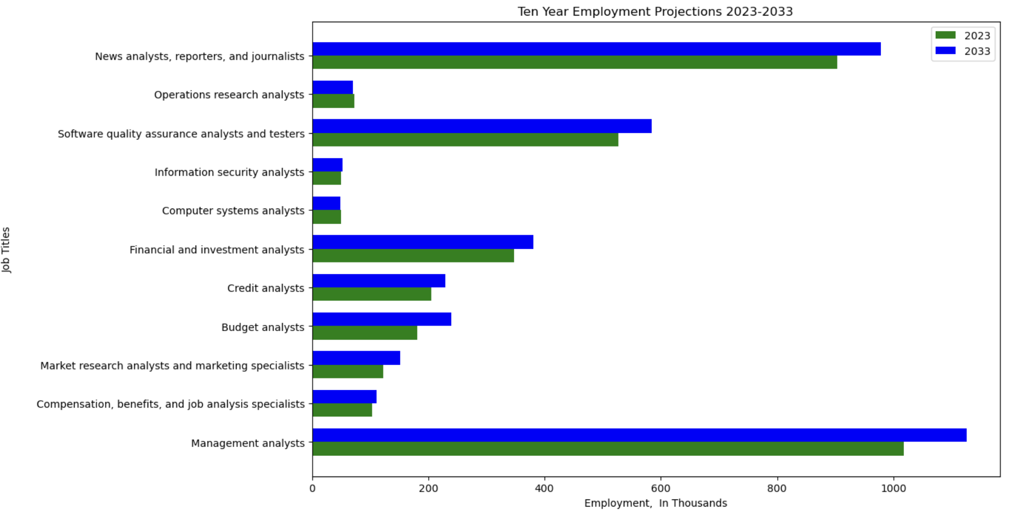
10 Year Projection
Notes:
Grant

Slide 26
1,000,000 +
Management Analyst Jobs in 2033
Notes:
Grant

Slide 27
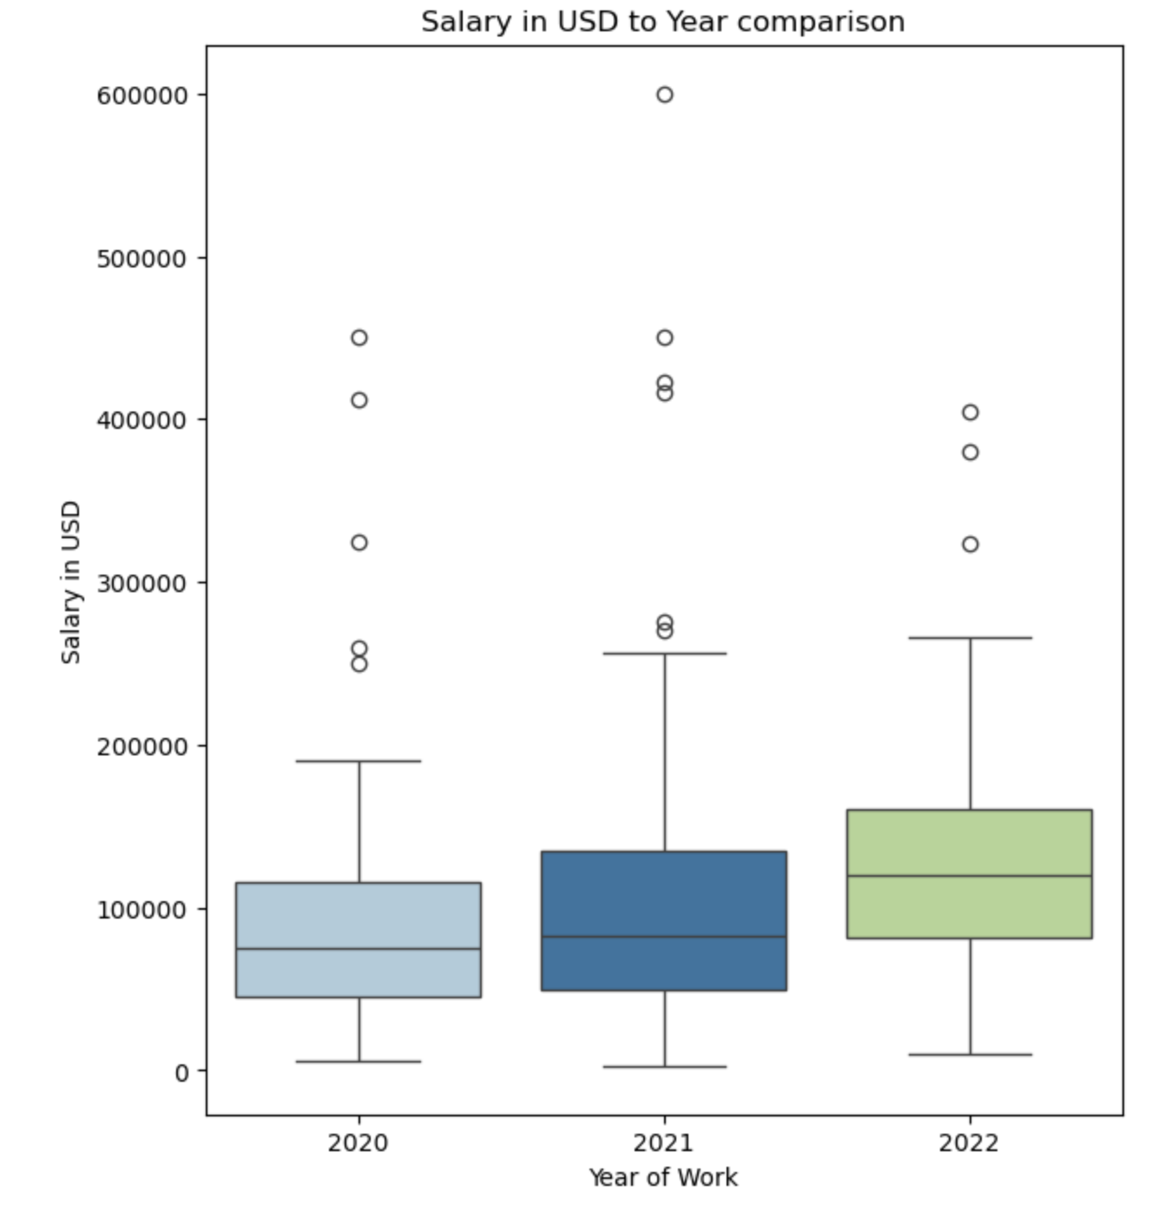
What have the past few years in salaries looked like?
Notes:
Grant

Slide 28
Where is Data Analytics Going?
What does the industry look like in 10 years?
05
From the data gathered we can infer that this industry is only growing. With the projected growth in job opening that we see to 2033. We can also see based off the past few years that salaries for this industry are also increasing gradually.
Notes:
Grant

Slide 29
Thank you!
Any questions?
Notes:
Grant

